Slide 1

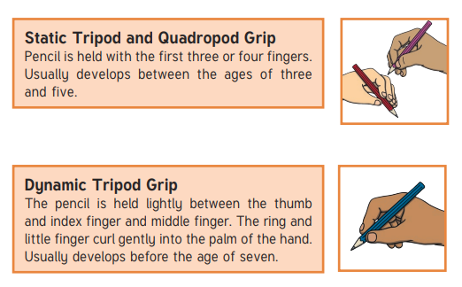
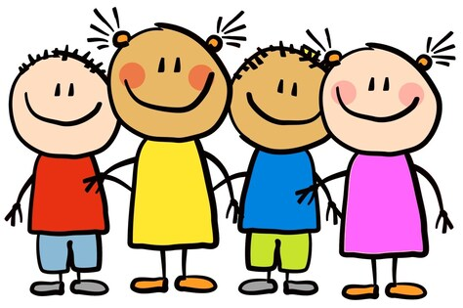

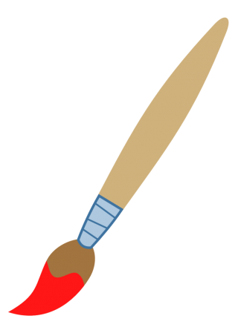
Physical development
Gross Motor
Within PE we will be exploring the movement of animals using our bodies in time with the speed of the music in ‘Gym in the Jungle’.
Fine Motor
We will be working on our fine motor ensure we are using a tripod grip to make marks with pencils and pens. We will strengthen this by cutting, threading, building and moulding.
Understanding of the world & personal, social and emotional.
We explore the environment around us will go on an Autumn walk.
Have a look at the changes in seasons and the different weather that it brings.
We look at where we belong in the world.
All about me
Jigsaw: Being in my World
Expressive arts and design
We will be painting our own self portraits detailing our facial features.
Recall and enjoy singing popular nursery rhymes.
Construct simple structures using a range of materials.
We begin to talk about feelings and welcome distractions when upset.
Children will increasingly follow rules and identify their likes and dislikes.
We will begin to independently organise belongings in the morning.
Children will manage their personal hygiene.
We will learn to build constructive and respectful relationships.
How to help at home
Send in photos of your immediate and extended family.
Take photos of your child outside of their house to compare the different houses we live in.

Slide 2


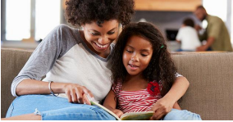
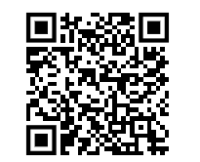

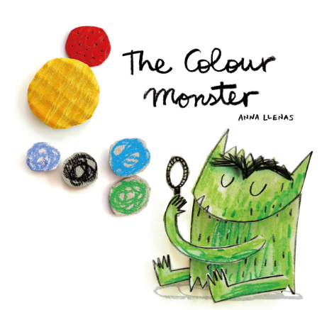


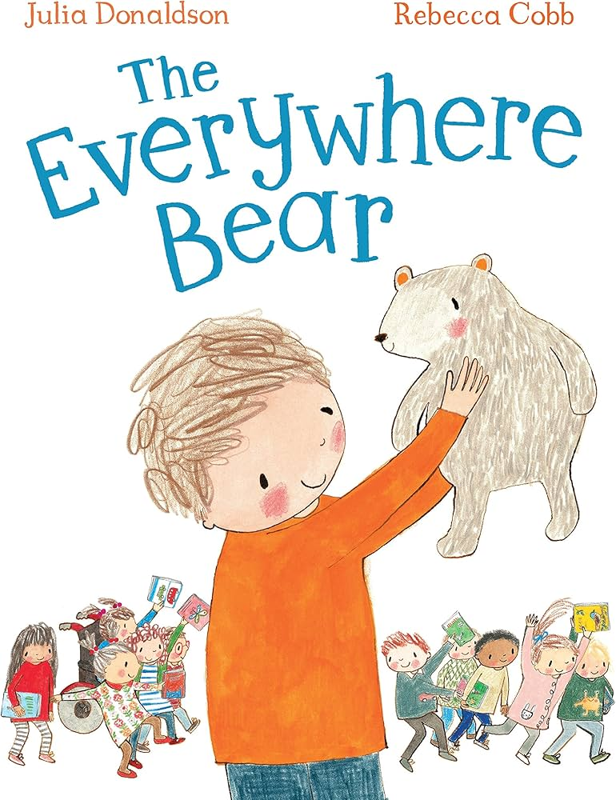
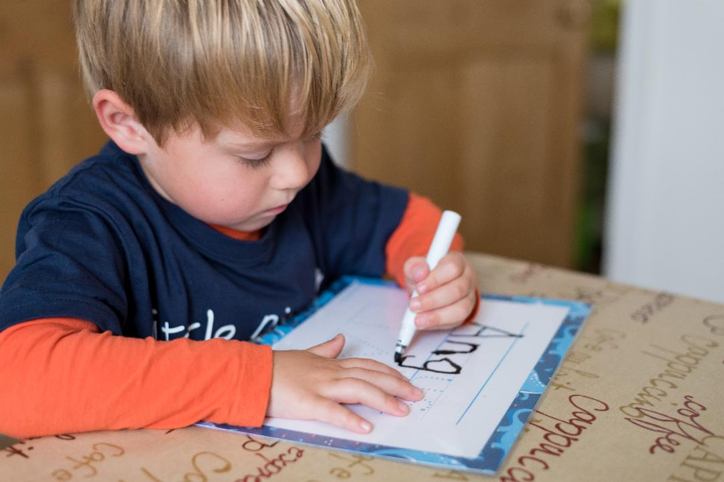
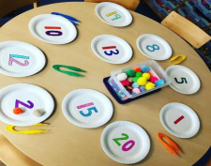
We are practicing
Orally segmenting simple words.
Recognize Phase 2 letters and sounds.
Daily handwriting practice of names and words.
We are practicing :
Matching and sorting objects into different groups based on different properties.
Comparing mass and size.
Creating simple patterns
Link to Autumn 1 sounds
Books we will be reading this half term.
What can you do to help your child’s learning and development at home.
Practice counting and recognizing numbers to 20.
Practice ordering numbers to 10.
Practice patterns, making different patterns from shapes, colours and objects.
Play oral blending games with your child.
Engage with the weekly phonics sheets.
Practice name writing with your child.

