Slide 1



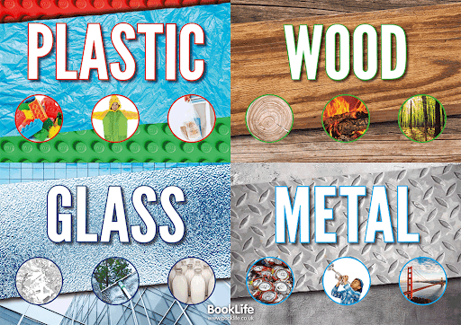



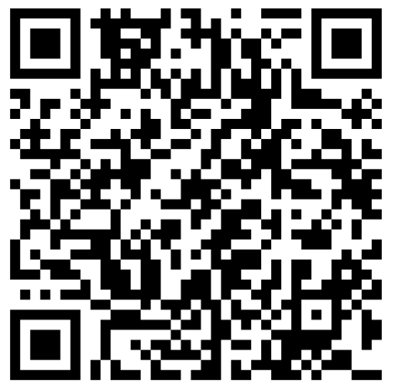
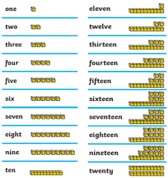

Within our sentence work we will be focusing on capital letters, finger spaces and full stops as well as adding description (adjectives)
Reading
We will enjoy lots of different experiences this half term through daily reading, drop and read, guided reading and library sessions
During this topic we will investigate materials and everyday objects using our observational skills!
Autumn 1
Our focus will be number, place value and shape. We will also learn our number pairs to 10 eg. 2+8=10, 6+4=10
Religious Education
What do Christians believe God is like?
We will be reading stories from the Bible to learn how God is loving and forgiving
Scan to play your number pairs to 10!
#

Slide 2



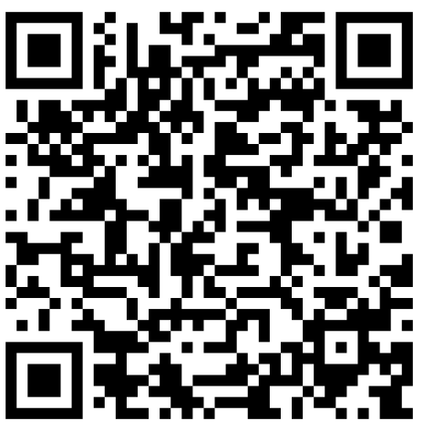


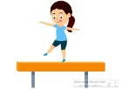


Art
We will be starting our exciting new project called “Colour Chaos” which is all about choosing, using and mixing primary colours to create secondary colours. We will enjoy experimenting to produce different styles of art
Geography
We will explore our school environment using observations as well as learning essential map skills
We will be learning how to use the Chromebooks to log on and off with our own passwords and
My Musical Heartbeat- We will be learning what a ‘beat’ is and create our own patterns through the programme
“Charanga”
PE
Indoor: Gymnastics- we will be learning to lift, carry and use apparatus safely. We will practise different movements and shapes to make sequences ready to perform!
Outdoor: Send and return- we will learn to control a ball by rolling, throwing, bouncing and catching. We will play simple team games, learn to follow rules and support each other!
PSHE
Being me in my world: We will share ideas about how to care for others to make our class a happy and safe place

